Slide 1

Button control Wrestle Omibox
Yahboom

Slide 2
1
2
3
4
5
Learning
goals
Search for
blocks
Combine
blocks
Experimental
phenomena
Preparation
程序编程
Tencent

Slide 3
1
Preparation-1
Preparation-1
1. The position of the button in the robot car
2. Learn how to use button graphically programming block

Slide 4

1
Preparation-2
As shown in the figure above,we circled the blue wire frame with two buttons, and we can control them by programming.

Slide 5
2
Learning goals
In this lesson, we will learn how to use the buttons.
When the red button is pressed, right hand of wrestle Omibox will lift up .
When the red button is not pressed, right hand of wrestle Omibox will put down.
When the green button is pressed, left hand of wrestle Omibox will lift up.
When the green button is not pressed, left hand of wrestle Omibox will put down.

Slide 6
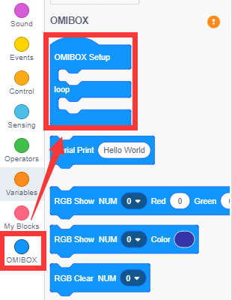
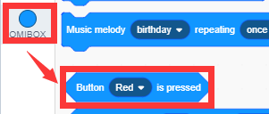
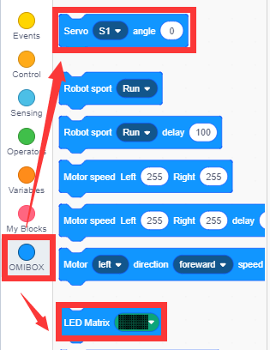
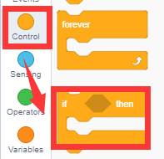
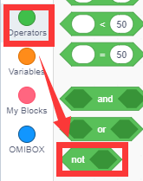
3
Search for blocks
The following is the location of the building blocks required for this programming.

Slide 7
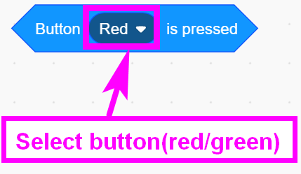
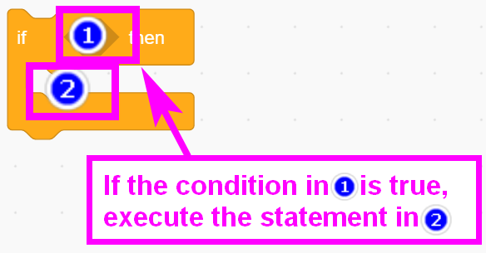
3
Search for blocks

Slide 8
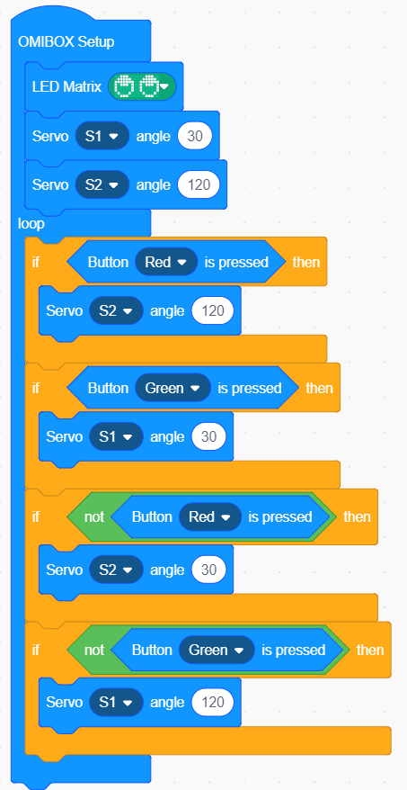
4
Combine blocks
The summary program is shown below:

Slide 9
5
Experimental phenomena
!!!Note: When use servo in the first time,we need to remove the gear on the building block servo.Then, download the program to micro:bit. Next, turn on the power of the robot and wait for the building block servo to turn to the initial position and turn off the power. Finally, we need to install the gear on the building block servo. Left hand and right hand will put down, in initial status.
Open the power of Wrestle Omibox,
When the green button is pressed, Omibox start to attack.
When the green button is not pressed, Omibox recover .

Slide 10
Inspire Creativity Embrace Innovation
Thank you!!!
Yahboom

